Slide 1
Introducing to Y86

Slide 2
Topics
Y86 instruction set architecture
Suggested Reading: 4.1

Slide 3
Goal
Understanding the instruction encodings
Preparing for designing your
  assembler
  simulator
  computer

Slide 4
Y86 Processor State
Program Registers
  Same 8 as with IA32. Each 32 bits
Condition Codes
  Single-bit flags set by arithmetic or logical instructions
    OF: Overflow ZF: Zero SF: Negative
Program Counter
  Indicates address of instruction
Memory
  Byte-addressable storage array
  Words stored in little-endian byte order
Program registers
%eax
%esi
%ecx
%edi
%edx
%esp
%ebx
%ebp
Condition codes
OF
ZF
SF
PC
Memory

Slide 5
Y86 Instructions
Format
  1--6 bytes of information read from memory
    Can determine instruction length from first byte
    Not as many instruction types, and simpler encoding than with IA32
  Each accesses and modifies some part(s) of the program state

Slide 6
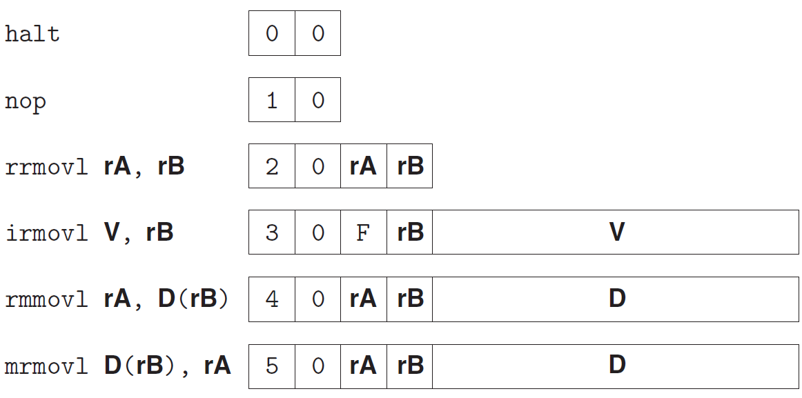
Y86 Instructions
Format (P259)
  1--6 bytes of information read from memory
    Can determine instruction length from first byte
    Not as many instruction types, and simpler encoding than with IA32
  Each accesses and modifies some part(s) of the program state
Errata: JXX and call are 5 bytes long.

Slide 7
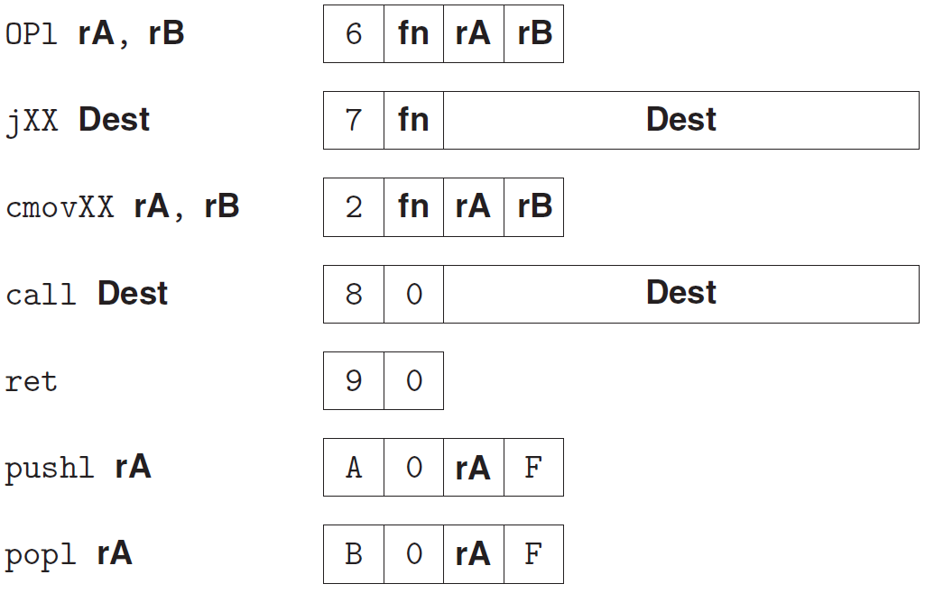
Format (P259)
  1--6 bytes of information read from memory
    Can determine instruction length from first byte
    Not as many instruction types, and simpler encoding than with IA32
  Each accesses and modifies some part(s) of the program state
Errata: JXX and call are 5 bytes long.

Slide 8
Encoding Registers
1
Each register has 4-bit ID
  Same encoding as in IA32, but IA32 using only 3-bit ID
Register ID F indicates “no register”
  Will use this in our hardware design in multiple places
%eax
0
%esi
6
%ecx
1
%edi
7
%edx
2
%esp
4
%ebx
3
%ebp
5

Slide 9
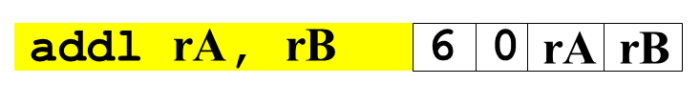
Instruction Example
Addition Instruction
  Add value in register rA to that in register rB
    Store result in register rB
    Note that Y86 only allows addition to be applied to register data
  Set condition codes based on result
Generic Form
Encoded Representation

Slide 10
Instruction Example
Addition Instruction
  e.g., addl %eax,%esi Encoding: 60 06
  Two-byte encoding
    First indicates instruction type
    Second gives source and destination registers
Generic Form
Encoded Representation

Slide 11
Arithmetic and Logical Operations
Instruction Code
Function Code
Add
  Refer to generically as “OPl”
  Encodings differ only by “function code”
    Low-order 4 bites in first instruction word
  Set condition codes as side effect
  Notice: no multiply or divide operation
addl rA, rB
6
0
rA
rB
Subtract (rA from rB)
subl rA, rB
6
1
rA
rB
And
andl rA, rB
6
2
rA
rB
Exclusive-Or
xorl rA, rB
6
3
rA
rB

Slide 12
Move Operations
rrmovl rA, rB
2
0
rA
rB
Register --> Register
irmovl V, rB
3
0
F
rB
V
Immediate --> Register
rmmovl rA, D(rB)
4
0
rA
rB
D
Register --> Memory
mrmovl D(rB), rA
5
0
rA
rB
D
Memory --> Register
Like the IA32 movl instruction
Simpler format for memory addresses
Give different names to keep them distinct

Slide 13
Move Instruction Examples
IA32
Y86
movl $0xabcd, %edx
irmovl $0xabcd, %edx
movl %esp, %ebx
rrmovl %esp, %ebx
movl -12(%ebp),%ecx
mrmovl -12(%ebp),%ecx
movl %esp,0x12345(%edx)
rmmovl %esp,0x12345c(%edx)
movl $0xabcd, (%eax)
—
movl %eax, 12(%eax,%edx)
—
movl (%ebp,%eax,4),%ecx
—

Slide 14
Move Instruction Examples
Y86
Encoding
irmovl $0xabcd, %edx
30 F2 cd ab 00 00
rrmovl %esp, %ebx
20 43
mrmovl -12(%ebp),%ecx
50 15 f4 ff ff ff
rmmovl %esp,0x12345(%edx)
40 42 45 23 01 00

Slide 15
Conditional Move Operations
Refer to generically as “cmovXX”
  Share the same “instruction code” with rrmovl
Encodings differ only by “function code”
cmovle rA, rB
2
1
rA
rB
cmovl rA, rB
2
2
rA
rB
cmove rA, rB
2
3
rA
rB
cmovne rA, rB
2
4
rA
rB
cmovge rA, rB
2
5
rA
rB
cmovg rA, rB
2
6
rA
rB
Based on values of condition codes
Same as IA32 counterparts

Slide 16
Jump Instructions
Jump Unconditionally
  Refer to generically as “jXX”
  Encodings differ only by “function code”
  Based on values of condition codes
  Same as IA32 counterparts
  Encode full destination address
    Unlike PC-relative addressing seen in IA32
jmp Dest
7
0
Dest
Jump When Less or Equal
jle Dest
7
1
Dest
Jump When Less
jl Dest
7
2
Dest
Jump When Equal
je Dest
7
3
Dest
Jump When Not Equal
jne Dest
7
4
Dest
Jump When Greater or Equal
jge Dest
7
5
Dest
Jump When Greater
jg Dest
7
6
Dest

Slide 17
Y86 Program Stack
Stack Bottom
Region of memory holding program data
Used in Y86 (and IA32) for supporting procedure calls
Stack top indicated by %esp
  Address of top stack element
Stack grows toward lower addresses
  Top element is at lowest address in the stack
•
•
•
Increasing
Addresses
%esp
Stack Top

Slide 18
Stack Operations
pushl rA
a
0
rA
F
Decrement %esp by 4
Store word from rA to memory at %esp
Like IA32 (pushl %esp → save old %esp)
Read word from memory at %esp
Save in rA
Increment %esp by 4
Like IA32 (popl %esp → movl (%esp) %esp)
popl rA
b
0
rA
F

Slide 19
Subroutine Call and Return
call Dest
8
0
Dest
Push address of next instruction onto stack
Start executing instructions at Dest
Like IA32
Pop value from stack
Use as address for next instruction
Like IA32
ret
9
0

Slide 20
Miscellaneous Instructions
nop
1
0
Don’t do anything
Stop executing instructions
IA32 has comparable instruction, but can’t execute it in user mode
We will use it to stop the simulator
halt
0
0

Slide 21
Y86 Instructions
Format (P259)
  1--6 bytes of information read from memory
    Can determine instruction length from first byte
    Not as many instruction types, and simpler encoding than with IA32
  Each accesses and modifies some part(s) of the program state
Errata: JXX and call are 5 bytes long.

Slide 22
Format (P259)
  1--6 bytes of information read from memory
    Can determine instruction length from first byte
    Not as many instruction types, and simpler encoding than with IA32
  Each accesses and modifies some part(s) of the program state
Errata: JXX and call are 5 bytes long.

Slide 23
Y86 Programs
int Sum(int *Start, int Count)
{
int sum = 0;
while (Count) {
sum += *Start;
Start++;
Count--;
}
return sum;
}

Slide 24
Y86 Assembly
IA32 code
int Sum(int *Start, int Count)
1 Sum:
2 pushl %ebp
3 movl %esp,%ebp
4 movl 8(%ebp),%ecx ecx = Start
5 movl 12(%ebp),%edx edx = Count
6 xorl %eax,%eax sum = 0
7 testl %edx,%edx
je .L34
Y86 code
int Sum(int *Start, int Count)
1 Sum:
2 pushl %ebp
3 rrmovl %esp,%ebp
4 mrmovl 8(%ebp),%ecx
5 mrmovl 12(%ebp),%edx
6 xorl %eax,%eax
7 andl %edx,%edx Set cc
8 je End

Slide 25
Y86 Instructions
IA32 code
9 .L35:
10 addl (%ecx),%eax add *Start to sum
11 addl $4,%ecx Start++
12 decl %edx Count--
13 jnz .L35 Stop when 0
14 .L34:
15 movl %ebp,%esp
16 popl %ebp
ret
Y86 code
9 Loop:
10 mrmovl (%ecx),%esi
11 addl %esi,%eax
12 irmovl $4,%ebx
13 addl %ebx,%ecx
14 irmovl $-1,%ebx
15 addl %ebx,%edx
16 jne Loop
17 End:
18 rrmovl %ebp,%esp
19 popl %ebp
20 ret

Slide 26
Y86 Object Program
1 # Execution begins at address 0
2 .pos 0
3 init: irmovl Stack, %esp # Set up stack pointer
4 irmovl Stack, %ebp # Set up base pointer
5 call Main # Execute main program
6 halt # Terminate program
7
Init part of program generated automatically
Assembler directives
  .pos 0, .pos 0x100
  .align
Symbolic Name

Slide 27
Y86 Object Program
8 # Array of 4 elements
9 .align 4
10 array: .long 0xd
11 .long 0xc0
12 .long 0xb00
13 .long 0xa000
14
Data area
  array denotes the start of an array
  Aligned on 4-byte boundary

Slide 28
Y86 Object Program
15 Main: pushl %ebp
16 rrmovl %esp,%ebp
17 irmovl $4,%eax
18 pushl %eax # Push 4
19 irmovl array,%edx
20 pushl %edx # Push array
21 call Sum # Sum(array, 4)
22 rrmovl %ebp,%esp
23 popl %ebp
24 ret
25

Slide 29
Y86 Object Program
26 # int Sum(int *Start, int Count)
27 Sum: pushl %ebp
28 rrmovl %esp,%ebp
29 mrmovl 8(%ebp),%ecx # ecx = Start
30 mrmovl 12(%ebp),%edx # edx = Count
31 xorl %eax,%eax # sum = 0
32 andl %edx,%edx # Set condition codes
33 je End

Slide 30
Y86 Object Program
34 Loop: mrmovl (%ecx),%esi # get *Start
35 addl %esi,%eax # add to sum
36 irmovl $4,%ebx #
37 addl %ebx,%ecx # Start++
38 irmovl $-1,%ebx #
39 addl %ebx,%edx # Count--
40 jne Loop # Stop when 0
41 End: rrmovl %ebp,%esp
42 popl %ebp
43 ret

Slide 31
Y86 Object Program
44
45 # The stack starts here and grows to lower addresses
46 .pos 0x100
47 Stack:
Programmers must write assembly codes themselves
  including manage the memory
    such as allocate memory for array and stack
    as well as avoid the memory overwritting

Slide 32
Assembling Y86 Program
  unix> yas eg.ys
Generates “object code” file eg.yo
  Actually looks like disassembler output

Slide 33
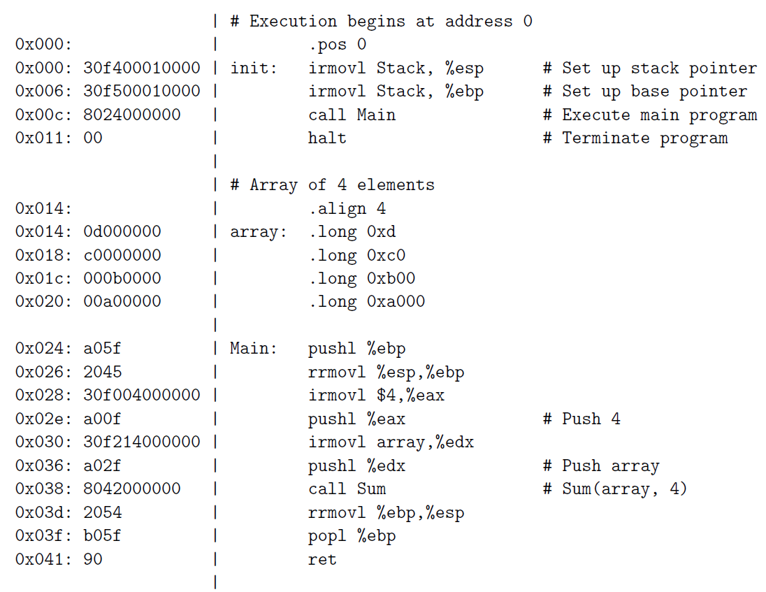
Y86 Object Program

Slide 34
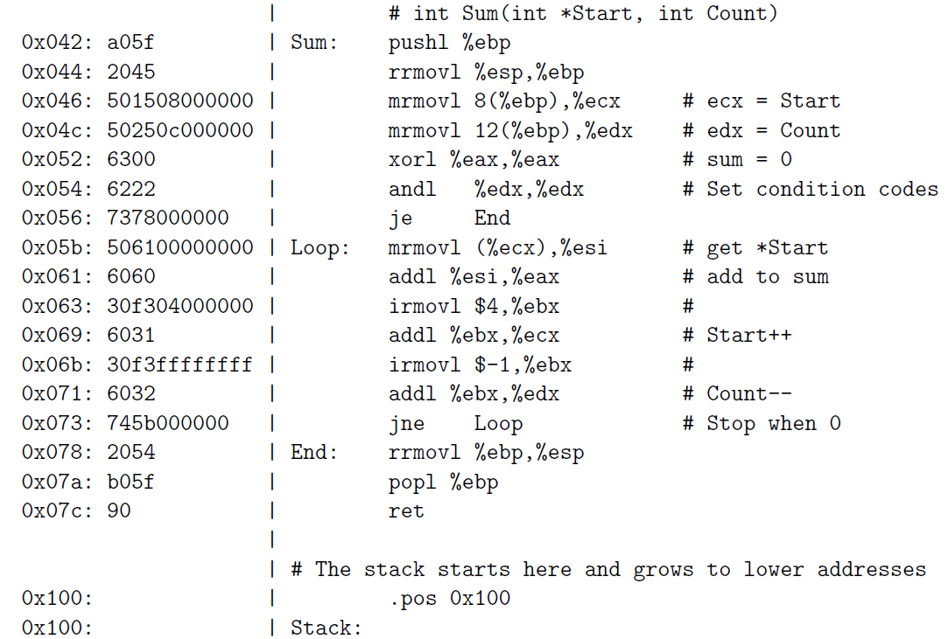
Y86 Object Program

Slide 35
Simulating Y86 Program
  unix> yis eg.yo
Instruction set simulator
  Computes effect of each instruction on processor state
  Prints changes in state from original

Slide 36
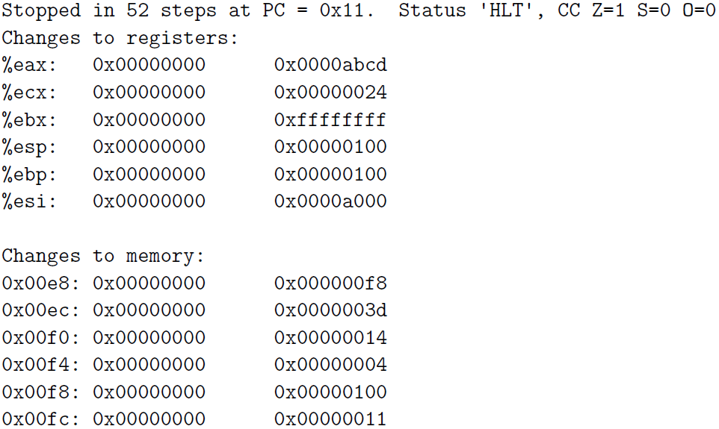
Simulating Y86 Program

